Slide 1
Lecture 4: Statistics in basketball

Slide 2
Goals
Overview of basketball stats
Possession based metrics
Tools
Efficiency & rate statistics
Expected value
Heat maps
Methods for categorical outcomes

Slide 3
Overview
1 – Possession based metrics
-What’s wrong with counting stats?
2 – Shifts in strategy
-Increased use of 3-pointer
3 – Next steps

Slide 4
Possession Based Metrics “A starting point for analyzing basketball statistics” -Kubatko, Oliver, Pelton, Rosenbaum, Journal of Quantitative Analysis in Sports -How to define a possession? For game Poss = FGA + 0.44*FTA –OREB + TO -More complicated formulas exist: above example shows correlation coefficient of 0.97 with actual possessions

Slide 5
Why possessions
1 – Team-level talent adjustments
-Which is better? A 10-point win in a 100 possession game or a 10-point win in a 150 possession game?
2 – Player level adjustments
-Easier to score 30 points in a 100 or 150 possession game?
3 – Rates > Counting metrics
-Examples in other sports

Slide 6
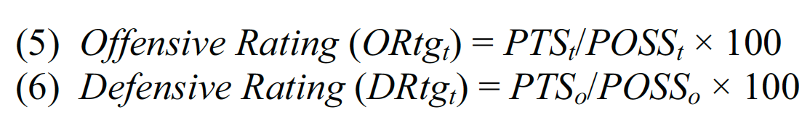
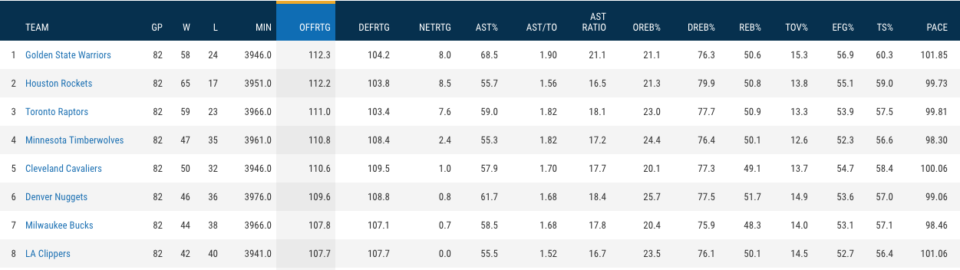
Offensive/Defensive ratings
-Reflect both efficiency and pace

Slide 7
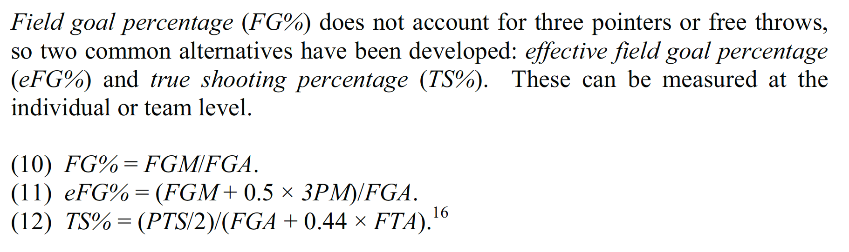
Player-specific rate statistics
eFG% and TS% reflect varying shot values (1, 2, 3):
- Similarities? Differences?
Similar rate statistics for rebounds

Slide 8
Extensions
“Four Factors”
“Plus-minus”
eFG%
Turnovers per possession
Offensive rebounding percentage
Free throw rate (FTM/FGA)
Points (or rating) when player on the court – Points (rating) when off the court
Often adjusted for game or teammates
Real plus-minus (Deadspin article)

Slide 9
State of current metrics
What impacts the likelihood of a shot going in?
What other questions are pertinent to basketball strategy?

Slide 10
State of current metrics
Consider the metrics: FG%, eFG%, FT-Rate, Plus-Minus
1 – Importance to winning
2 – Player-specific contributions (less team dependent)
3 – Repeatability

Slide 11
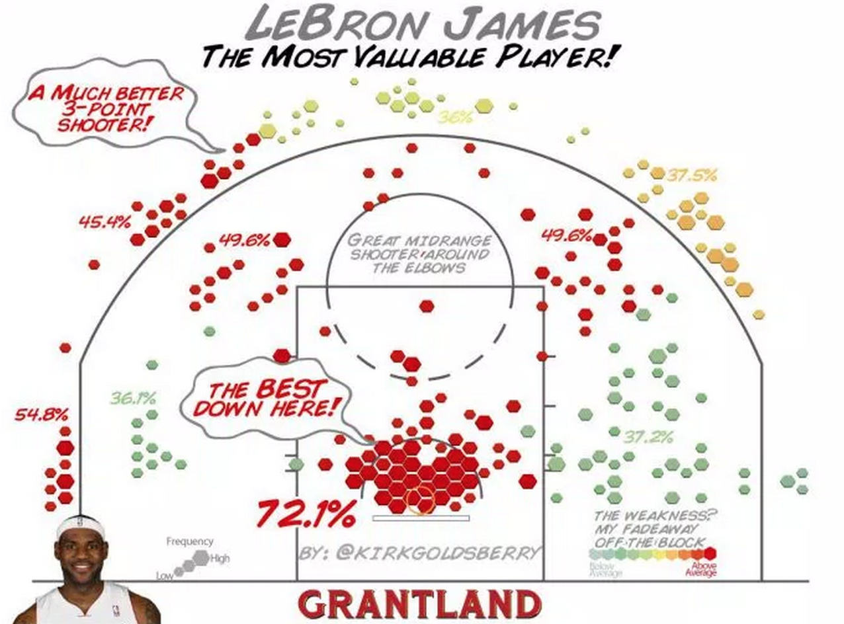
Extensions: shot charts

Slide 12
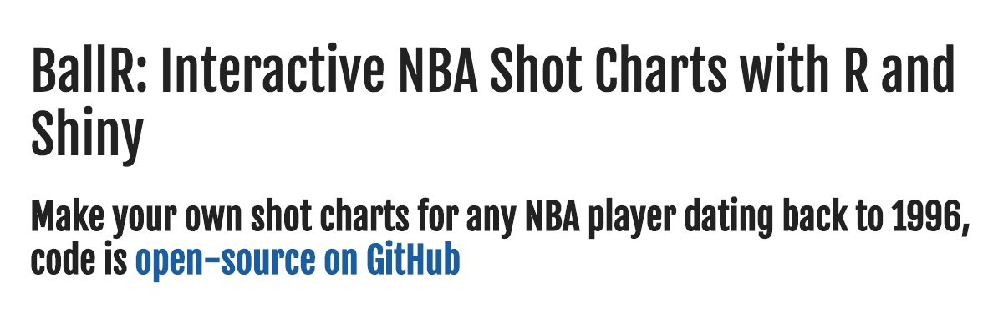
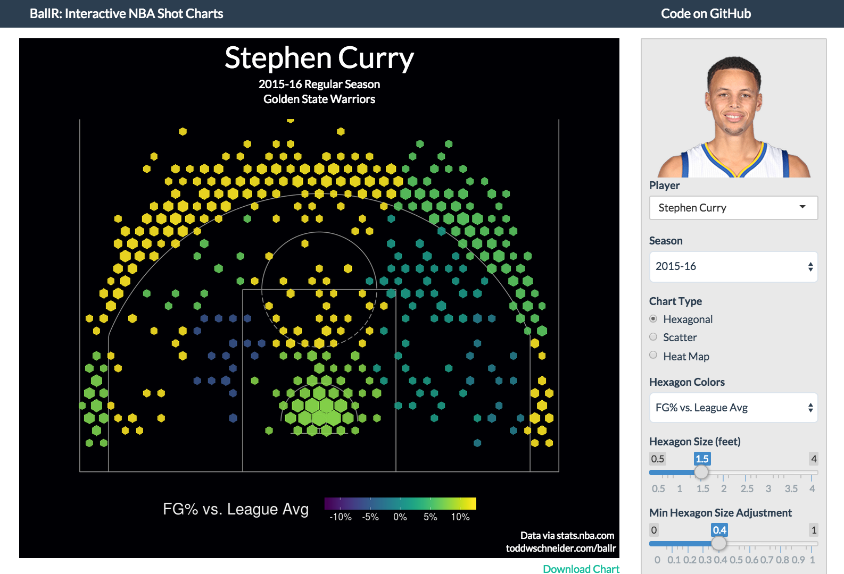
Extensions
http://toddwschneider.com/posts/ballr-interactive-nba-shot-charts-with-r-and-shiny/

Slide 13
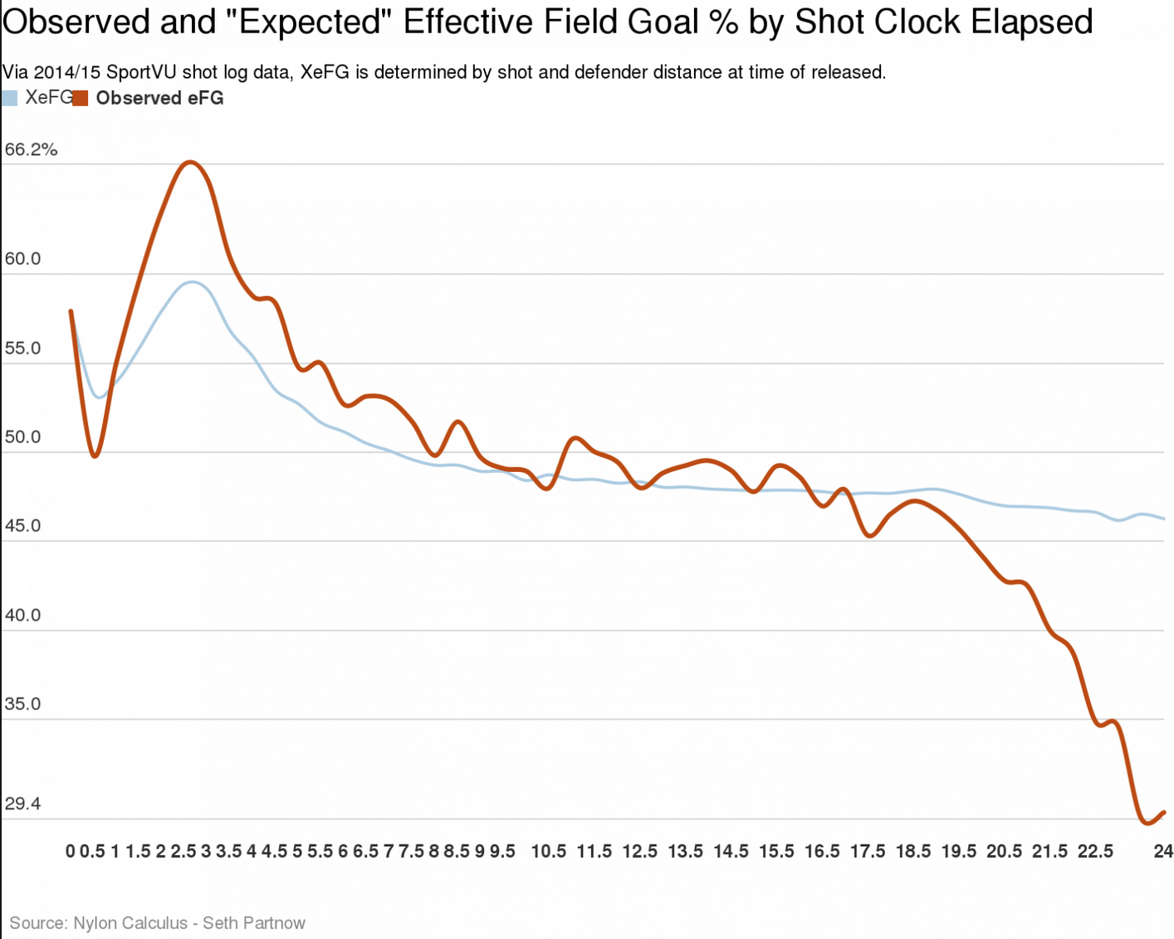
Adjustments: by shot time
https://www.washingtonpost.com/news/fancy-stats/wp/2015/08/28/ty-lawson-will-help-rockets-rely-less-on-james-harden/

Slide 14
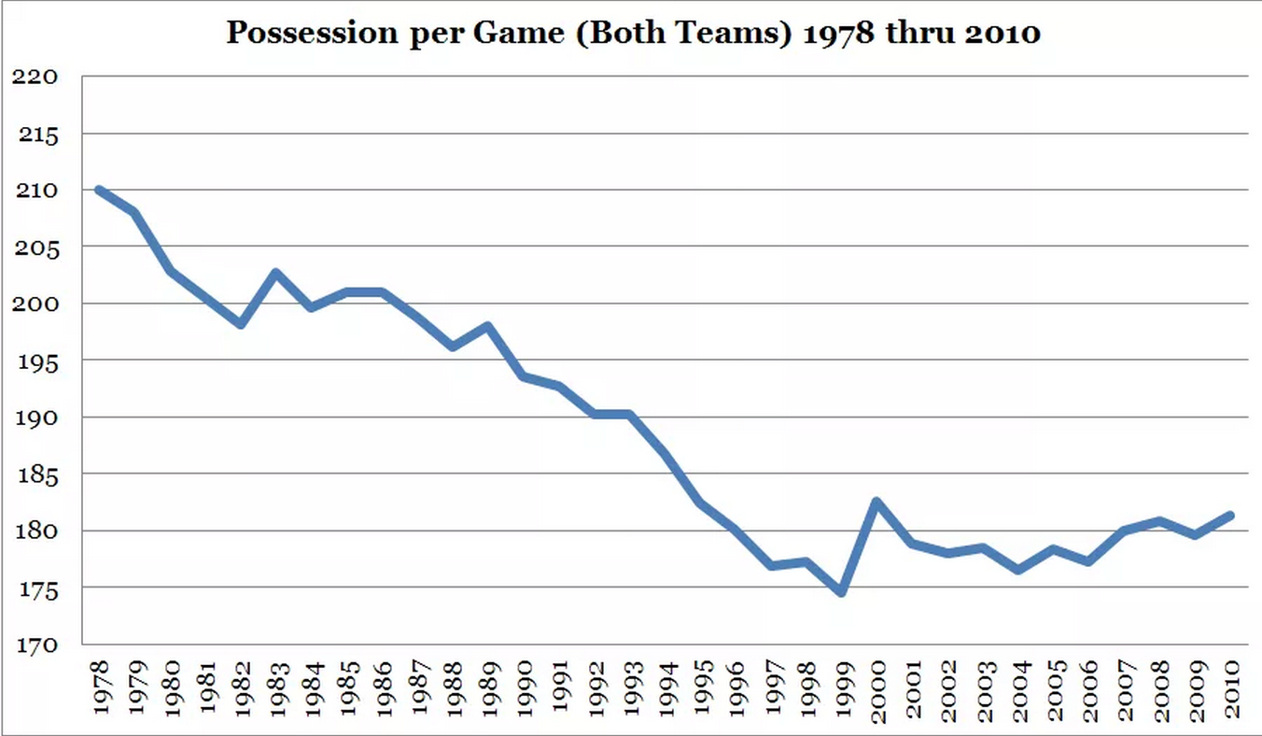
Adjustments: by era
http://basketballnumbers.com/2010/07/19/measuring-the-quality-of-basketball-in-the-nba-part2-adjusting-for-pace/

Slide 15
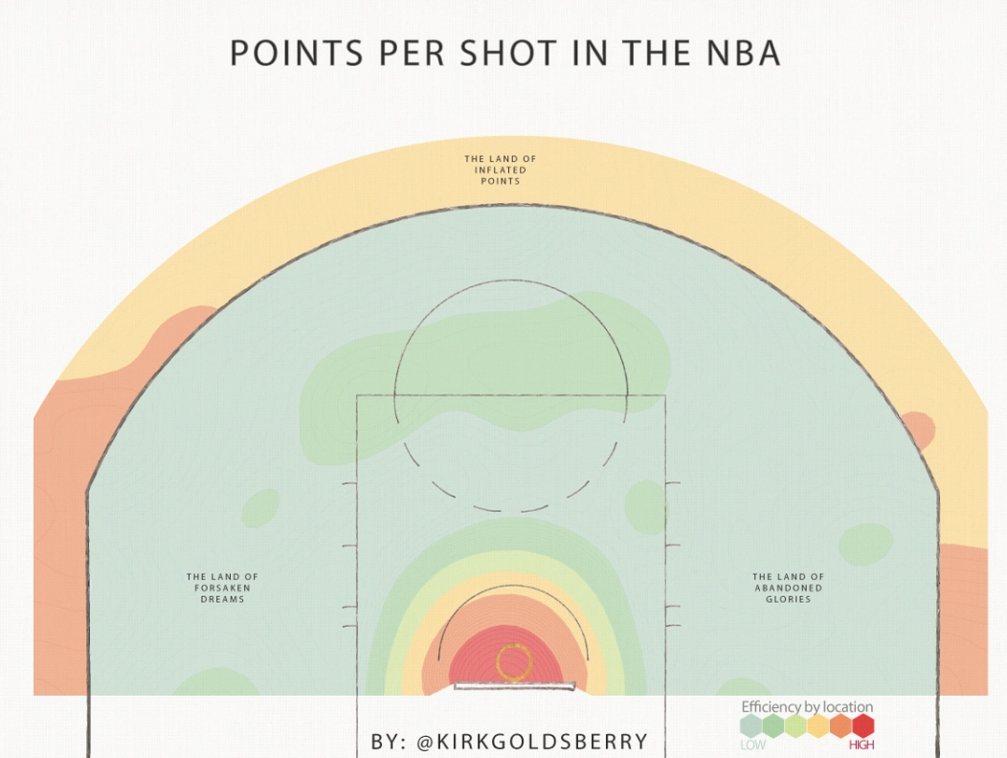
The three pointer
http://grantland.com/the-triangle/is-it-time-to-move-the-nba-3-point-line-back/

Slide 16
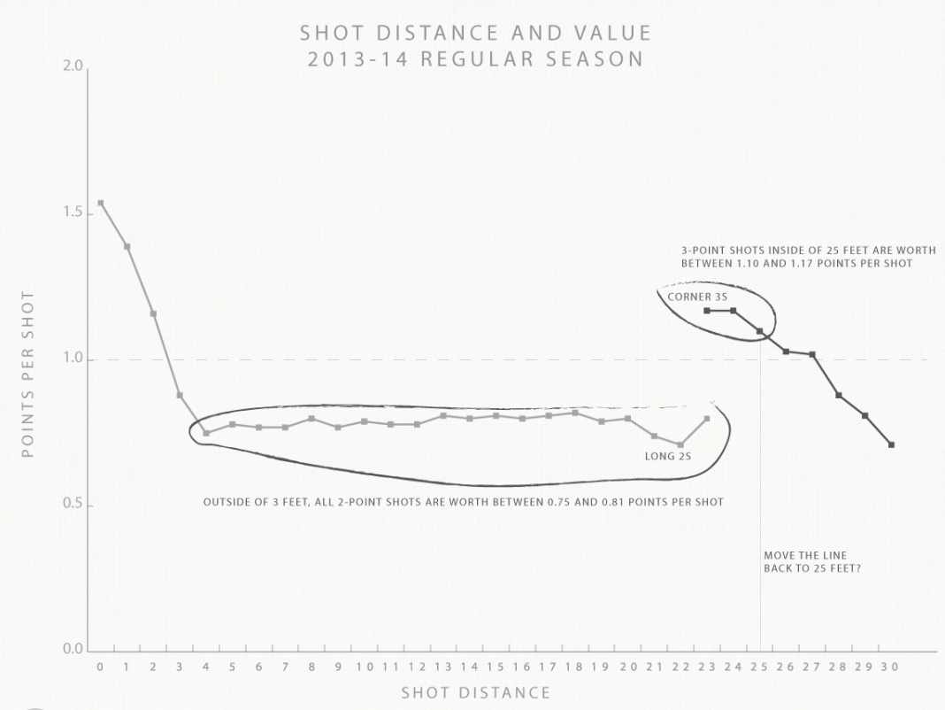
The three pointer
http://grantland.com/the-triangle/is-it-time-to-move-the-nba-3-point-line-back/

Slide 17
The future
https://github.com/dcervone/EPVDemo/blob/master/EPV_demo.pdf
https://twitter.com/StatsbyLopez/status/707293839539605505

